Slide 1
Great Outdoors – Use Case Diagrams

Slide 2
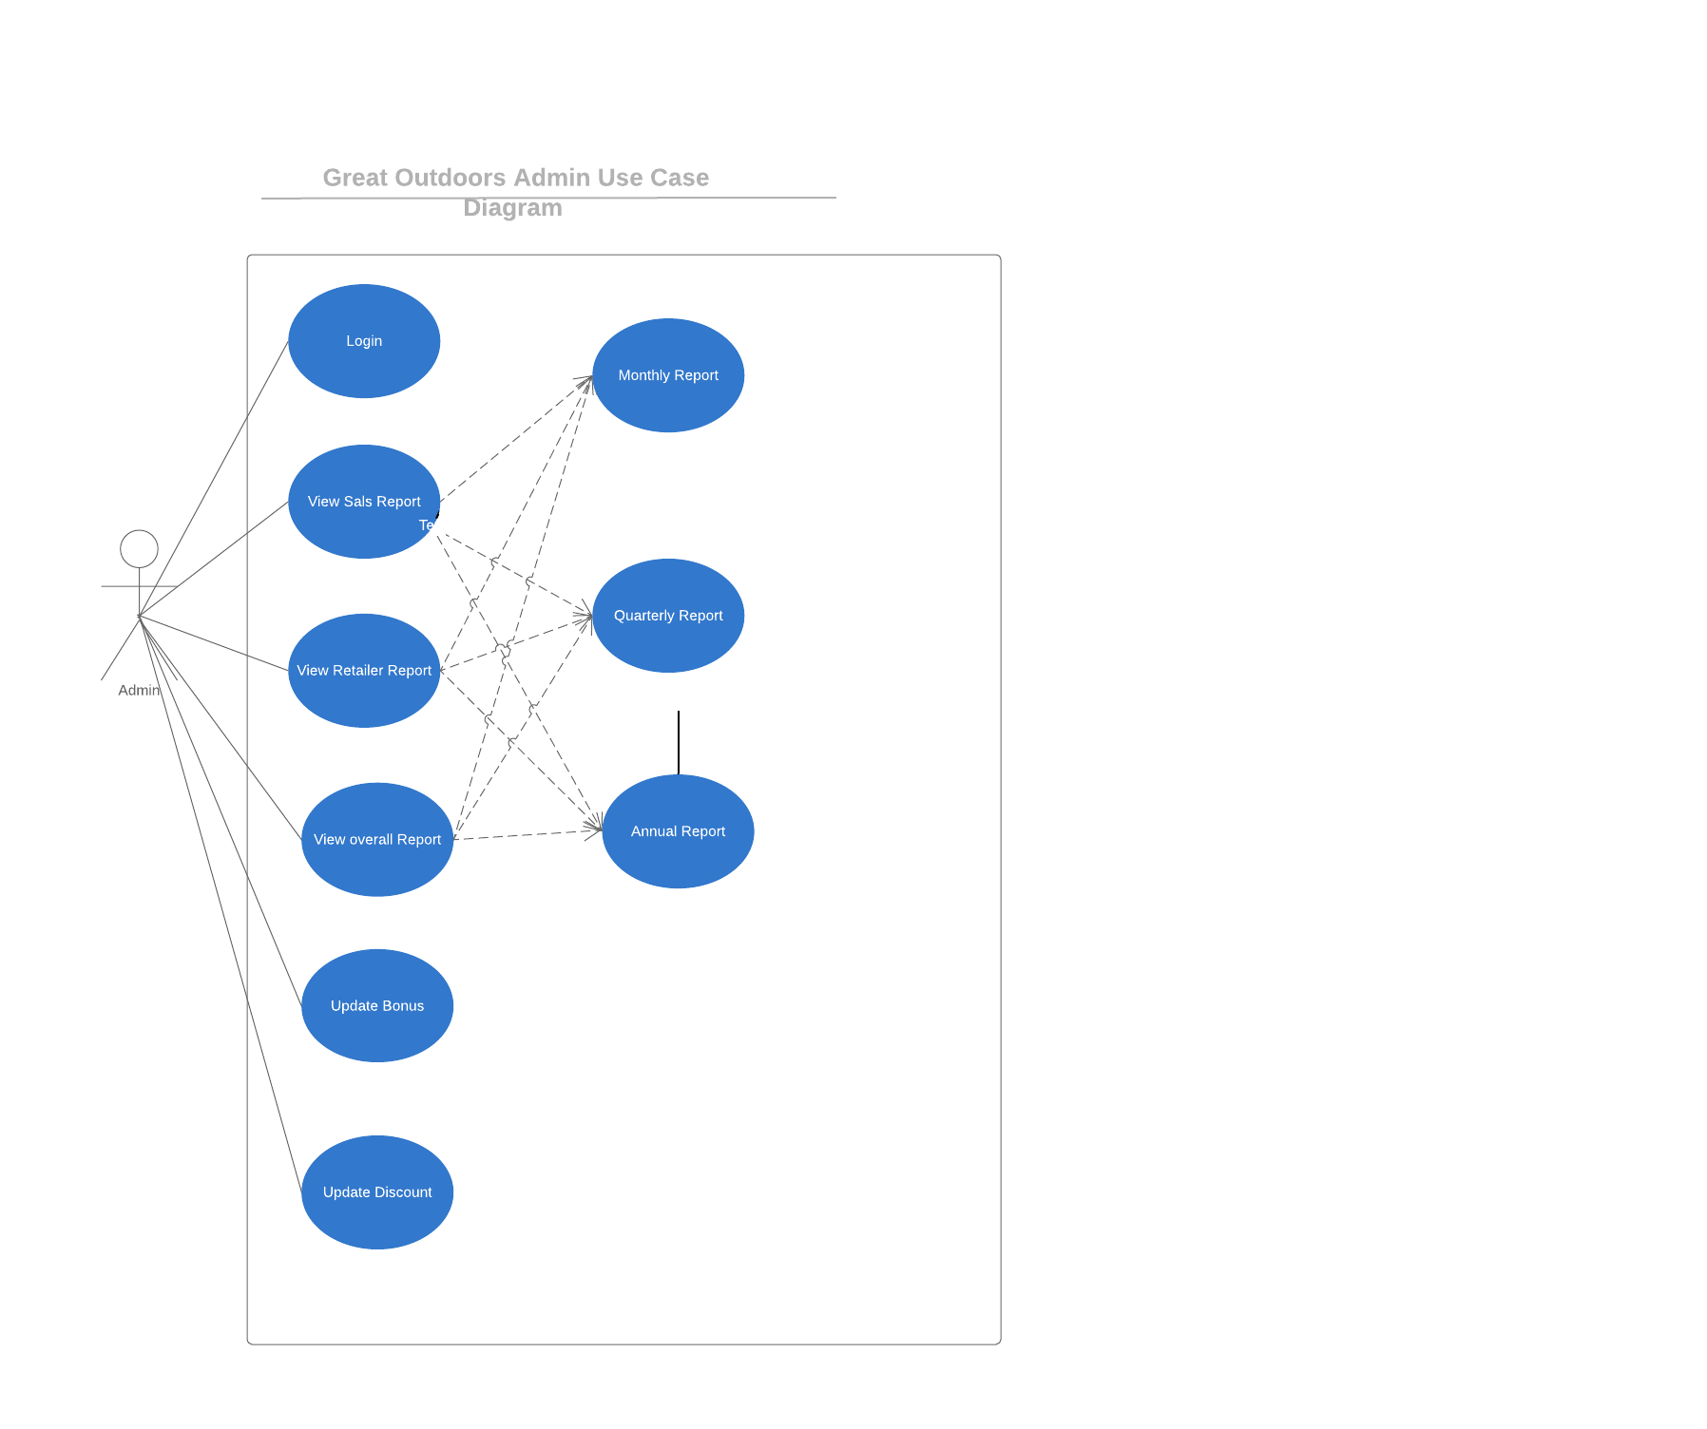


Slide 3
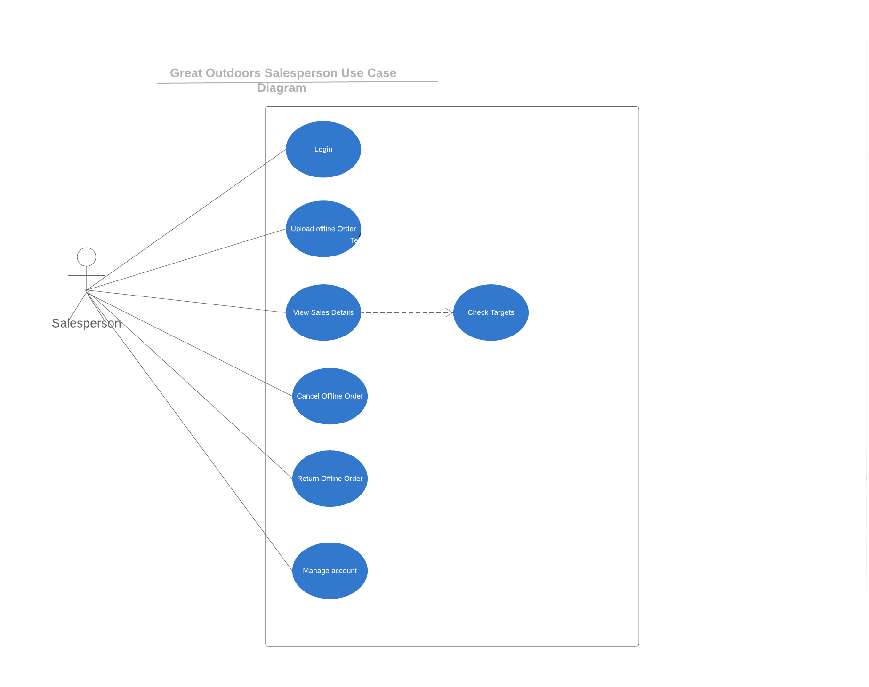


Slide 4
